Slide 1



FIRE DETECTION & ALERT SYSTEM
Incorporating Automatic Fire Mitigation and Safety Guidance

Slide 2
PRESENTED BY
Sumona Islam
ID: 20220204072
Jannatul Mawa
ID: 20220204074
Siddika Sultana Mitu
ID: 20220204078

Slide 3
INTRODUCTION
  Smart Fire Detection and Mitigation System using Arduino
  Automatically detects fires and initiates mitigation.
  Provides safety guidance for evacuation.
  Ensures rapid response and reduces potential damage.

Slide 4
OBJECTIVES
  Detect fire quickly and reliably using sensors.
  Alert occupants locally with a buzzer and LED.
  Send remote alerts via SMS using the GSM module.
  Automatically initiate fire suppression using a mini peristaltic pump.
  Provide clear safety guidance and evacuation instructions on an LCD screen.

Slide 5
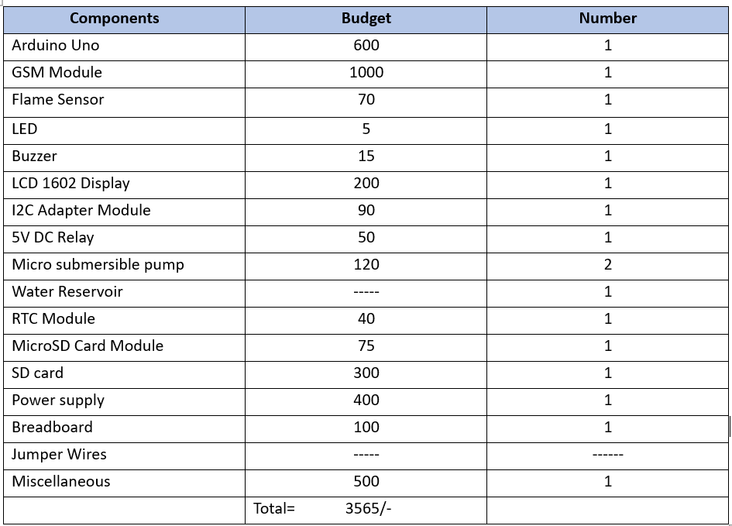
COMPONENTS USED

Slide 6
WORKING PRINCIPLE
  Flame sensor detects fire.
  Arduino activates buzzer, LED, and sends SMS via GSM module.
  Arduino displays safety messages on LCD.
  Arduino triggers relay to start the pump and suppress fire.

Slide 7
ADVANTAGES
  Early and reliable fire detection.
  Rapid alert dissemination (local and remote).
  Automatic fire suppression minimizes damage.
  Clear safety guidance facilitates safe evacuation.
  Reduces the risk of injury and property loss.
  Cost-effective fire safety solution.

Slide 8
SUSTAINABILITY, SAFETY & ENVIRONMENTAL IMPACT
  Reduces environmental damage by quickly suppressing fires.
  Ensures user safety with low-voltage components.
  Minimizes water waste through targeted suppression.
  Easy to install and maintain, for long-term use.
  Reduces overall environmental footprint.
  Promotes responsible component disposal and recycling.

Slide 9
CONCLUSION
  This Arduino-based fire detection and alert system provides early warning, automated mitigation, and clear guidance.
  It enhances safety, reduces potential damage, and offers a cost-effective solution.
  The system combines essential features for proactive fire protection.
  By integrating these elements, we've created a more secure environment.

Slide 10
THANK YOU

